Slide 1
Trailbot
Group 14: Brandon Christler, Michael Hitchcock, Garrett Monast, Yifan Wu

Slide 2
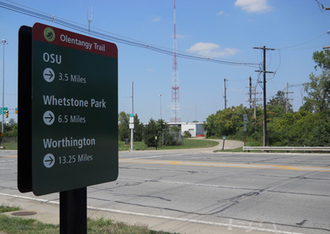
Topic Outline
Introduction
Problem Statement
The Solution
Technical
Requirements
Concepts Considered
Proposed Design
Design Analysis
Considerations & Constraints
Testing Plans
Project Management
Schedule
Resources and key components
Risks and challenges
Summary

Slide 3
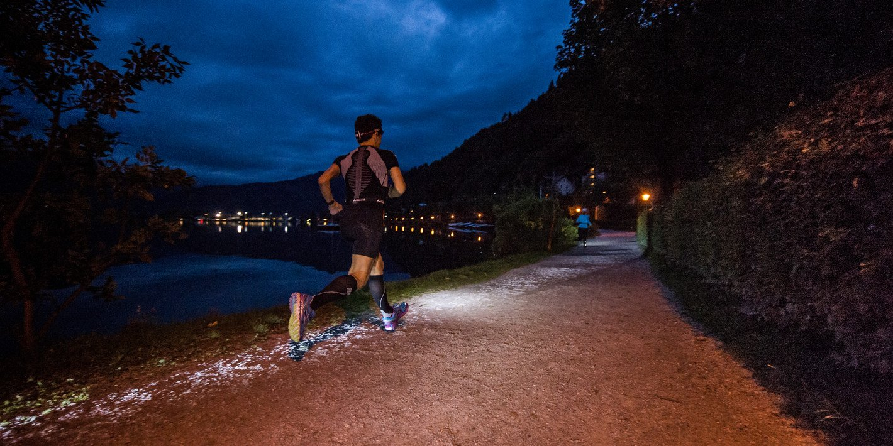
Problem Statement
Jogging is meant to be healthy and relaxing, but the challenges of busy schedules and the ever increasing number of personal gadgets to carry has made it hard to just get out onto the trail

Slide 4
The Solution?
Trailbot - A Jogging Compainion robot capable of:
Autonomously following the user
Mounting accessories such as LED Flashlights
Charing user’s electronic Devices
Carrying small items such as keys, wallets, and water bottles
Designed with today’s busy fitness enthusiast’s in mind, Trailbot will be able to support a runner day or night, Rain or Shine.

Slide 5
Requirements
Runtime
Minimum of one hour
Speed
Must be able to match distance runners
Minimum target of 25 kph
Accessory Functionality
Charge two electronics devices for duration
Provide illumination sufficient to avoid hazards on night runs
Follow feature
Accurately (±0.2m) trail user at set distance
Avoid all blocking obstacles
Cost
Minimized through avoidance of expensive components

Slide 6
Considered Concepts
Two primary concepts considered
Drone
Increased maneuverability
Increased complexity
Decreased functionality (as a result of weight limitations)
Increased cost
Land based vehicle
Increased payload
Longer runtimes
Less maneuverability by terrain
Reduced cost

Slide 7
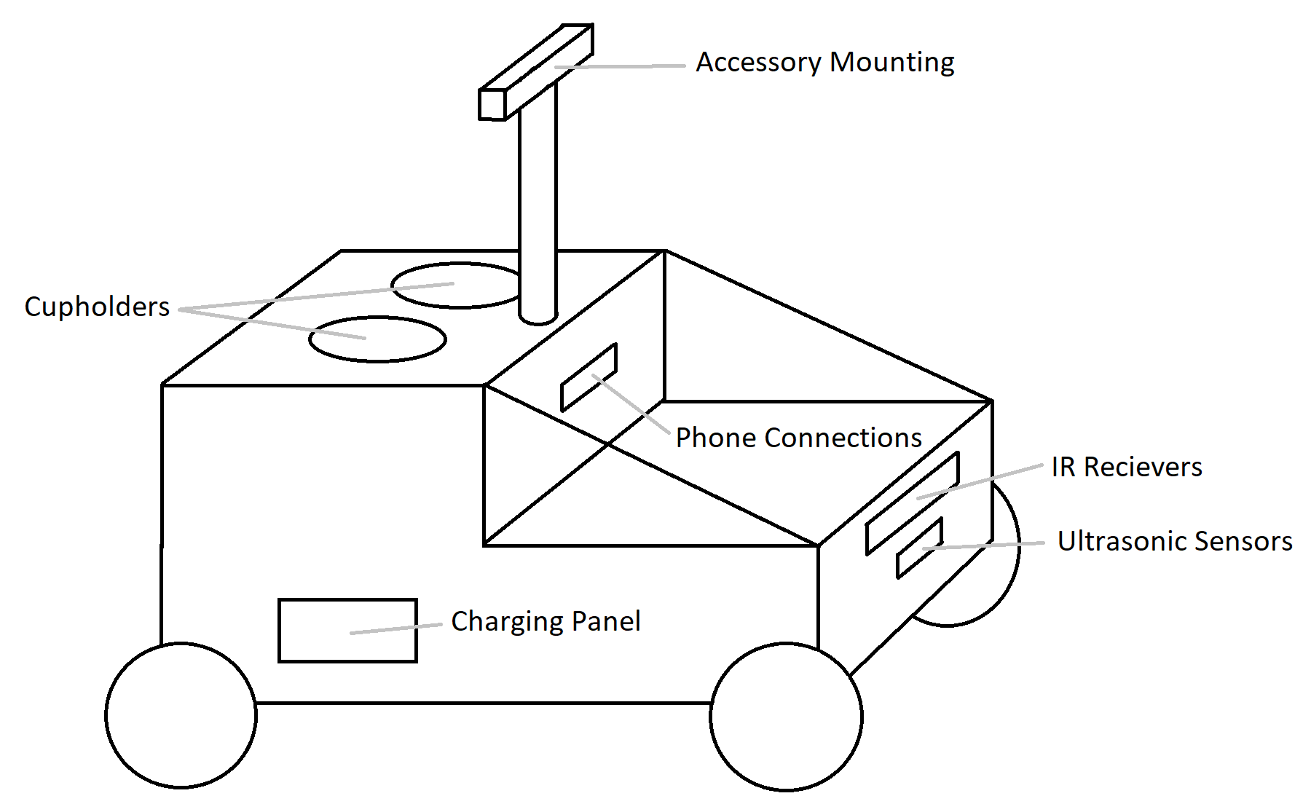
Proposed Design
Land based vehicle
Chosen primarily for increased runtime and decreased complexity
Features
Carries miscellaneous items in protected compartment while recharging electronics
Wheeled design efficiently moves on maintained trails and tracks
Accessory mounting allows illumination of trail
Sensors provide accurate navigation and obstacle avoidance

Slide 8
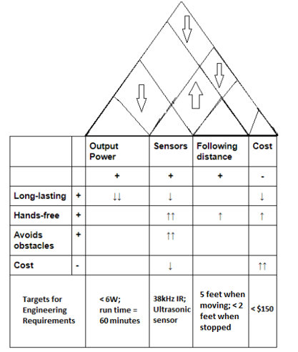
Design Analysis
Feature Priority
User tracking
Runtime
Accessory functionality
Small payload capacity
Electronics charging

Slide 9
Practical Considerations & constraints
Design
Time available
Design level
low level design versus using prepared components
Build
Materials and processes available
Implementation
Cost versus functionality

Slide 10
Testing Plans
Sensor Testing
Test Ultrasonic sensor sensitivity and applicability to obstacle avoidance
Test IR suitability for keeping heading
Control Testing
Activate all motor and servo functions through full range via Arduino
Final Testing
Integrate sensors into control system and experimentally verify that product meets requirements

Slide 11
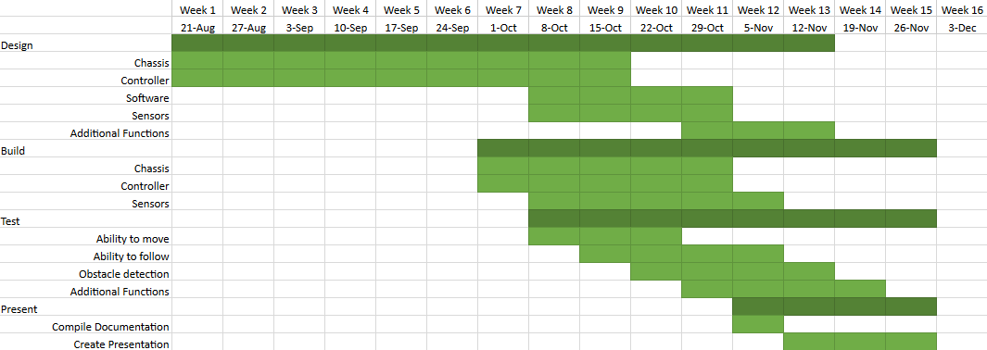
Schedule

Slide 12
Resources & key components
Required resources
Arduino IDE
Common electronic components and tools
Workshop for body fabrication
Key components
Arduino UNO ✔
Chassis with suspension and wheels ✔
Motor ✔
Servo ✔
Batteries ✔
Sensors ✔
Accessories

Slide 13
Risks & Challenges
Failure to implement all desired accessory features
Flexibility of ground based design allows simple addition and removal of accessories to the project
Failure to meet specified runtimes
Reduced weight constraints of ground design allows additional batteries
Failure to fully achieve desired autonomous following function
Early design and aggressive testing minimize chance of failure without time for rework
Failure to achieve speed goal
Will be avoided through early testing and flexibility in accessory design allowing changes to payload weight

Slide 14
Conclusion
Trailbot is a simple, user-tracking, obstacle-avoiding robot, designed specifically for paved trails, tracks, and roads, which will provide solutions to several problems encountered by joggers.
The team will construct a final design that is reliable, weather-resistant, low-cost, and relatively low-weight, with a battery life of at least one hour.
The design will combine the versatility and customizability of Arduino with the rugged, durable design of a commercial RC car chassis.

Slide 15
Questions?

